Slide 1
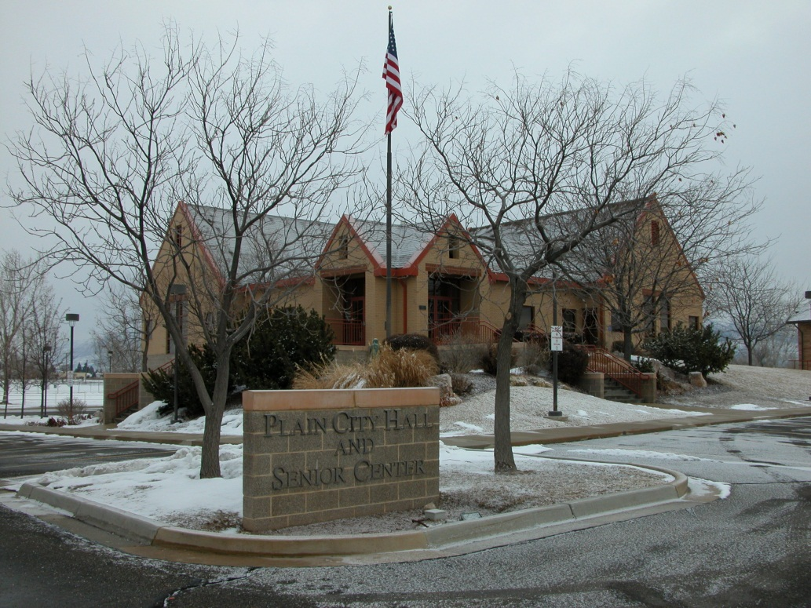
WEBER COUNTY SHERIFF’S OFFICE
PLAIN CITY
2013 YEAR END REPORT

Slide 2
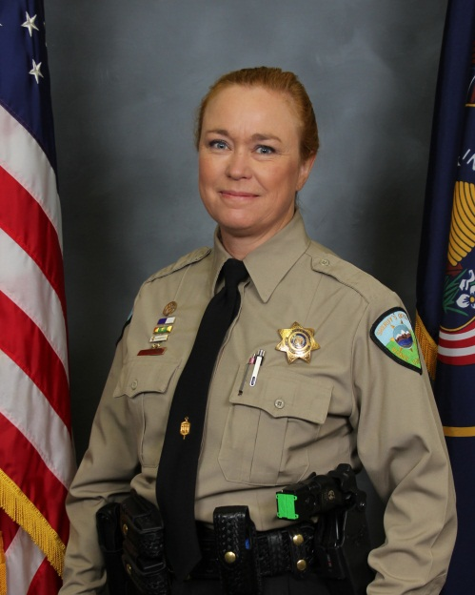

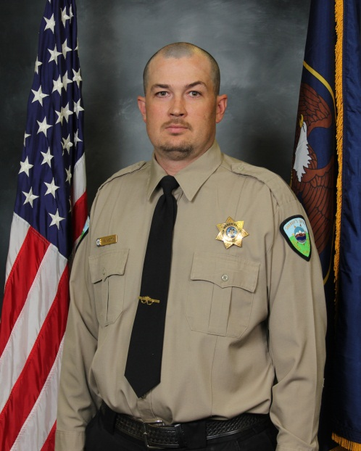
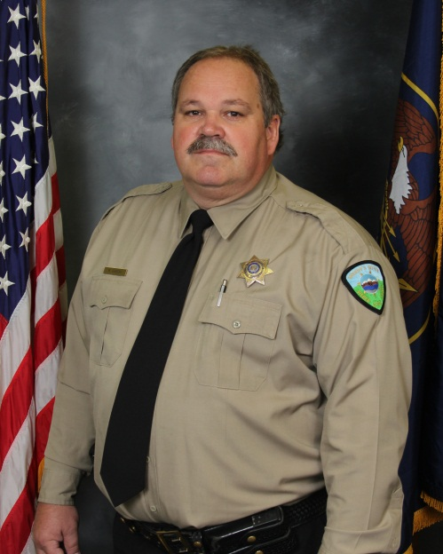
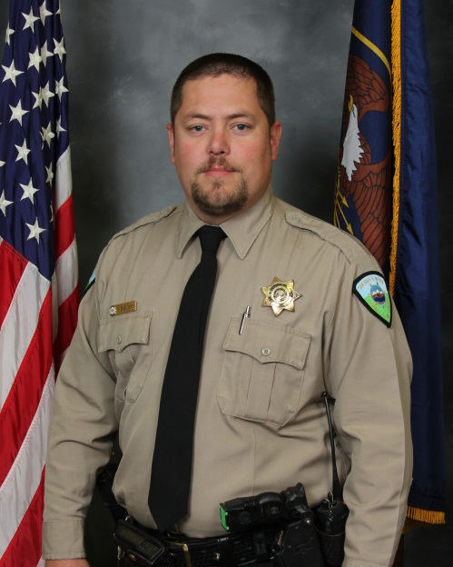
PLAIN CITY DEPUTIES
Kathy Stoffers
Weston Voth
Mark Hirschi
Paul Babinsky

Slide 3

RESOURCE SHARING
PLAIN CITY UNITS
DETECTIVES
PATROL
SCHOOLS

Slide 4

Plain City Units
ADMIN
Sheriff Thompson
Chief Anderson
Lt. Morrow
CORPORALS
1 West Haven
2 MSL
1 West
DEPUTIES
4 ½ West Haven
3 ½ Hooper
4 Farr West
SERGEANTS
4 West Patrol
1 Admin
PATROL

Slide 5

Chief Klint Anderson CHIEF DEPUTY
^{Sgt. Brent Butler WEST PATROL}
^{Cpl. Nichole Jones WEST HAVEN}
^{Sgt. Dave Maccines WEST PATROL}
^{Cpl. Craig Tillet MSL}
Lt. John Morrow PRECINCT COMMANDER
^{Sheriff Terry Thompson SHERIFF}
Sgt. Chris Stettler WEST PATROL
^{Sgt. Mike Streker WEST PATROL}
^{Cpl. Tyler Greenhalgh WEST}
^{Cpl. (VACANT) MSL}
^{Event Deputies (6)}
^{Deputy (VACANT) WEST HAVEN}
Deputy Colleen Clarke WEST HAVEN
^{Deputy Matt Nelson WEST HAVEN}
^{Deputy Mark Wian WH/HOOPER}
^{K-9 Tyrel Dalton FARR WEST}
Deputy Paul Babinsky PLAIN CITY
^{Deputy Jared Ortgiesen HOOPER}
^{Deputy John Millaway FARR WEST}
^{Deputy Weston Voth PLAIN CITY}
^{Deputy Jarrod Irvin HOOPER}
^{Deputy Rich Clawson FARR WEST}
Deputy Kathy Stoffers PLAIN CITY
Deputy Terrace Lavely WEST HAVEN
^{Deputy Curtis Jeffries HOOPER}
^{Deputy Matt Flinders FARR WEST}
^{Deputy Mark Hirschi PLAIN CITY}
^{Sgt. Lane Findlay WEST ADMIN}
WEST PRECINCT

Slide 6

RESOURCE OFFICERS
Sgt. Jason Talbot
Deputy Maria Garcia
(NOVA)
7 Other School Resource Officers
Deputy Doug Ney
DEPUTY DOUG NEY
FREMONT HIGH SCHOOL

Slide 7
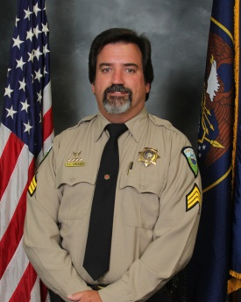
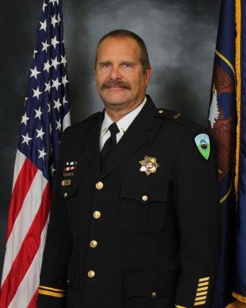
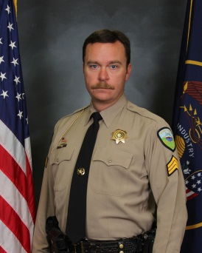
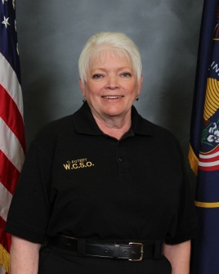
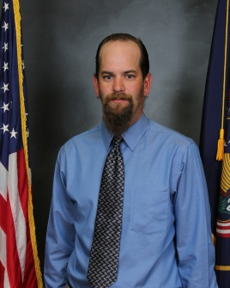
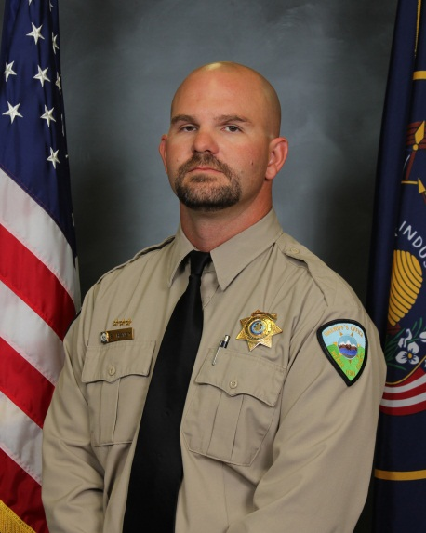
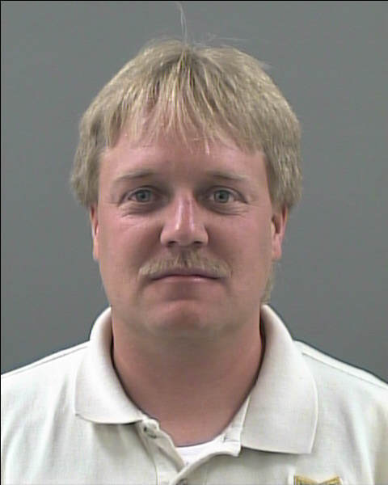

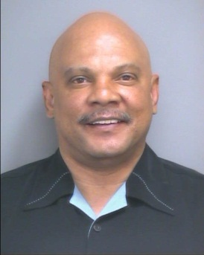
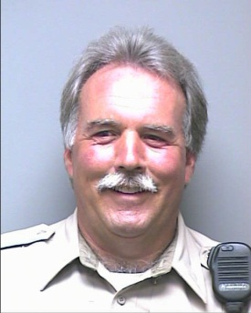
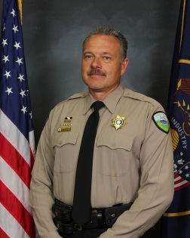
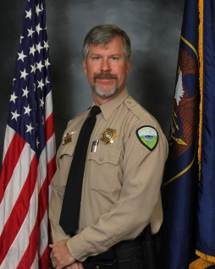
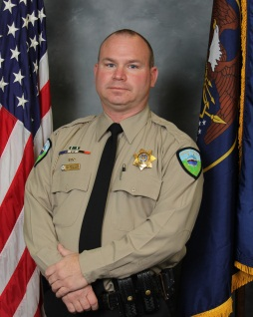
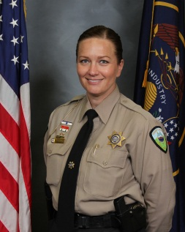
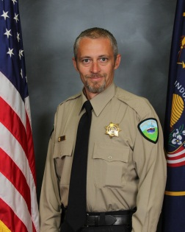
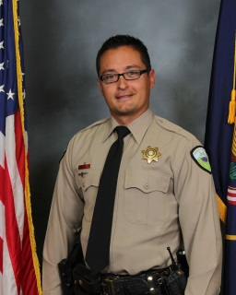
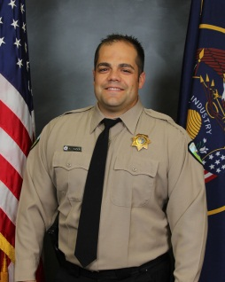
Sgt. Dave Creager
Supervisor
Sgt. Brion Flinders
Strike Force
Lt. Doug Coleman
Commander
Chris Poteet
Secretary
Agent Matt Jensen
Strike Force
Pat Donehoo
Civil
Les Townsend
Civil
Steve Haney
West Detective
INVESTIGATIONS
Ryan Read
West Detective
Don Kelly
RTTC
Eric Jones
General
Wade Follum
East
Stephanie Tatton
Sex Crimes
Scottie Sorensen
Financial Crimes
Cam Hartman
ICAC
Jeremy Rock
East

Slide 8

ALL THE OTHERS…
PLAIN CITY UNITS
East Precinct
Explorers
Corrections
Motors
Truck Inspector
EMT
SWAT
Bomb Tech
K-9
Training
Firearms
Search & Rescue
Evidence
Fleet
Corrections
Office Staff
Software Specialists

Slide 9

CALLS FOR SERVICE
  TOTAL CALLS
  2009 1485
  2010 1788
  2011 1738
  2012 1584
  2013 2023

Slide 10
INCREASES IN OFFICER INITIATED ACTIVITIES

Slide 11
STOPS & CITATIONS
5-YEAR COMPARISON

Slide 12
COMMUNITY POLICING

Slide 13
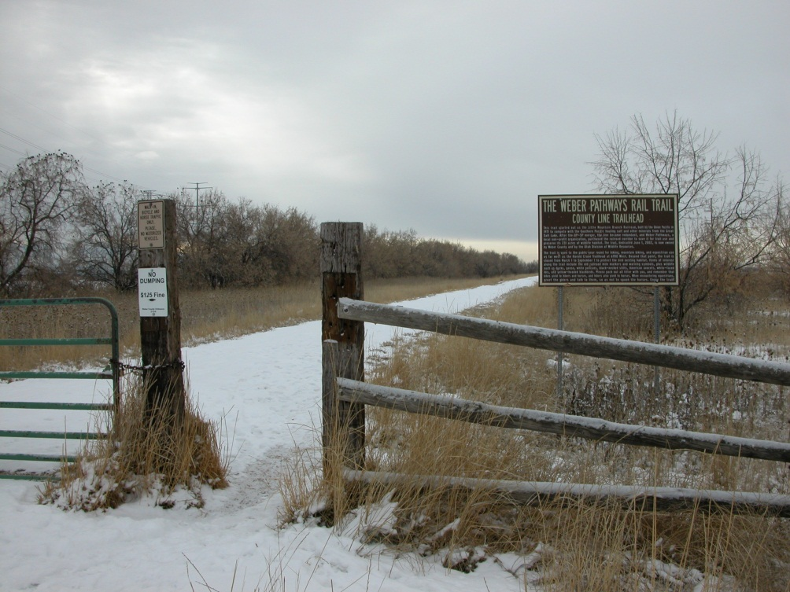
THE RAIL TRAIL PROJECT
LitterinG
LEWDNESS
DRUGS
Drinking
3500 W. 4000 N.
SOLUTION: Closing the Trail System Between 11:00 P.m. to 6:00 A.m. and posting “NO Overnight Parking” Signs TO Discourage ILLEGAL ACTIVIES.

Slide 14
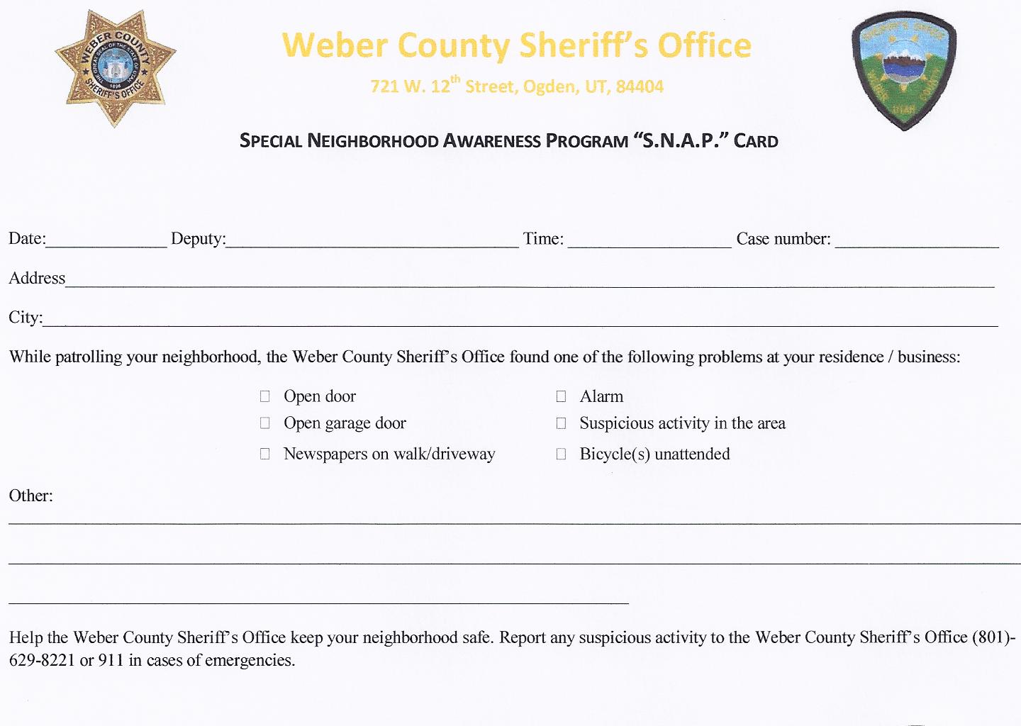
OH SNAP!

Slide 15
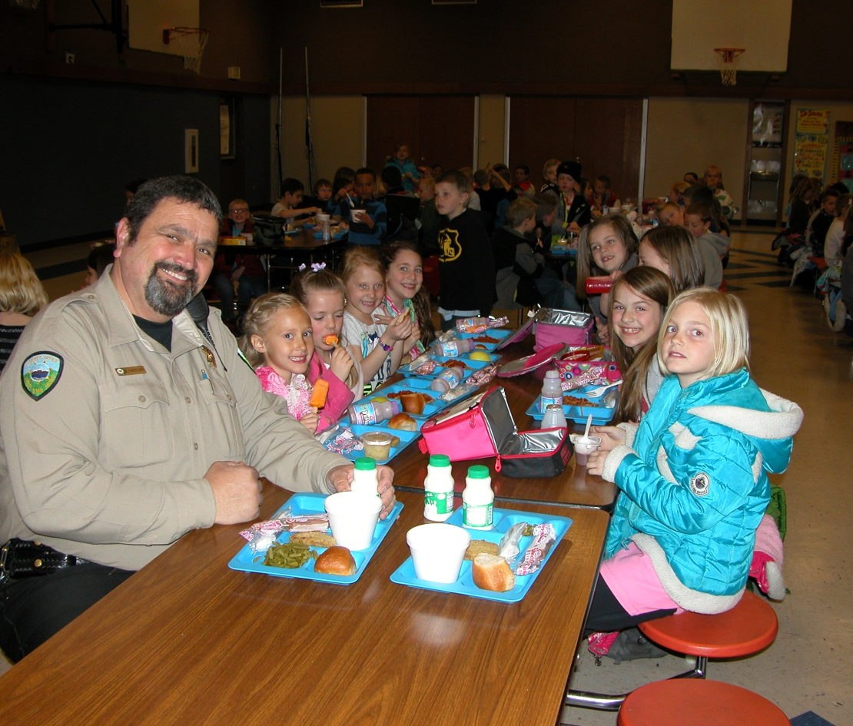
SCHOOL VISITS
PLAIN CITY ELEMENTARY
145
WELCOME SCHOOL RESOURCE
OFFICER MIKE CHATELAIN!

Slide 16
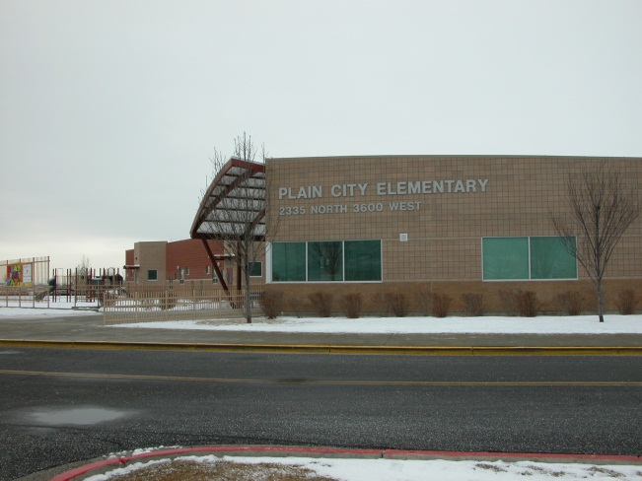
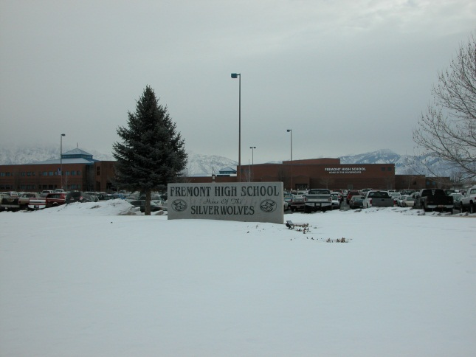
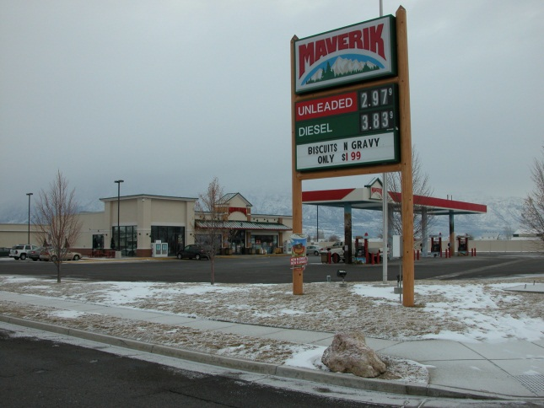
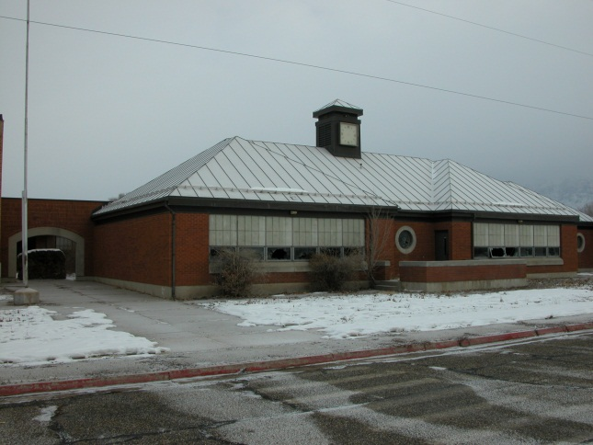
HIGH CALL VOLUME LOCATIONS
172
142
376 Calls
PLAIN CITY ELEM
FREMONT High
36
18.5%
Of total
26
MAVERIK
OLD SCHOOL

Slide 17
CRIME PATTERNS AND CONCERNS
Total call volume increased significantly in 2013. This was primarily due to an increase in traffic enforcement and community-policing efforts.
Overall, violent crime and property crime rates remain very low.
Deputies continue to respond to the old Plain City Elementary building on trespassing, vandalism, and suspicious activity calls.
Occasionally, serious crimes do occur such as the armed robbery at Maverik.
No major crime patterns were detected within the city.

Slide 18



QUESTIONS?
Follow us online @
www.co.weber.ut.us

